Slide 1

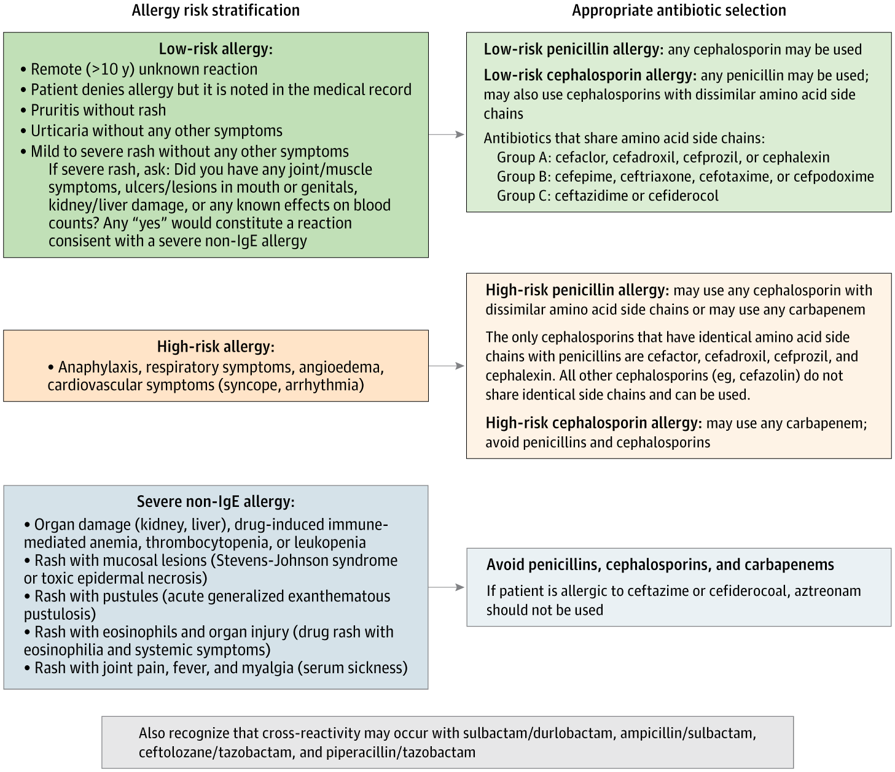
From: Intracameral Cefuroxime Use in Cataract Surgery After Penicillin Allergy Reclassification
JAMA Ophthalmol. Published online March 05, 2026. doi:10.1001/jamaophthalmol.2026.0040
^{Figure Legend:}
Flow Diagram Depicting Risk Stratification for Patients With an Allergy to Penicillin
^{Date of download: 3/24/2026}
Copyright 2026 American Medical Association. All rights reserved, including those for text and data mining, AI training, and similar technologies.2026American Medical Association

